Slide 1
BLAST-TNG 250um Map-Making
Jonah Lee

Slide 2
Motivation
3 roaches available
interest: looking at instrument/sky noise from each roach and learn about inter-network variation
exploit advantages of multiple roaches: find out what is common/error
instrument commonality
850GHz: 10-12 RF networks

Slide 3
Goals
TBD

Slide 4
Getting Things To Run
Roach 2, 4, 5 are 250um
To begin, use only roach 2 → end goal is to incorporate all together
Slice_i not defined
How is this obtained? For now, I assume it is the same as roach 1
KID rejects list not defined
For now, keep all KIDs
Detector layout not defined
This is not used directly by the map maker in the current version so we can comment out any code using this

Slide 5
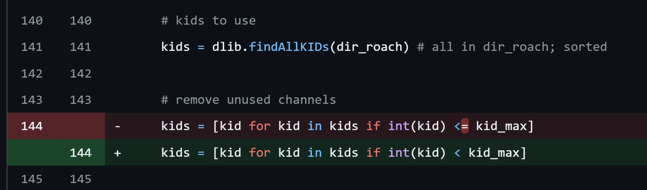
Target Sweeps Index Bug Fix?
kid_max is set to index 474 but there are only 474 target sweep .dat files
Either a target sweep file is missing, kid_max is off by one or we should have < instead of <=
Roach 1 does not have this problem, kid_max is 380 and we have 381 items in dat_targs.

Slide 6
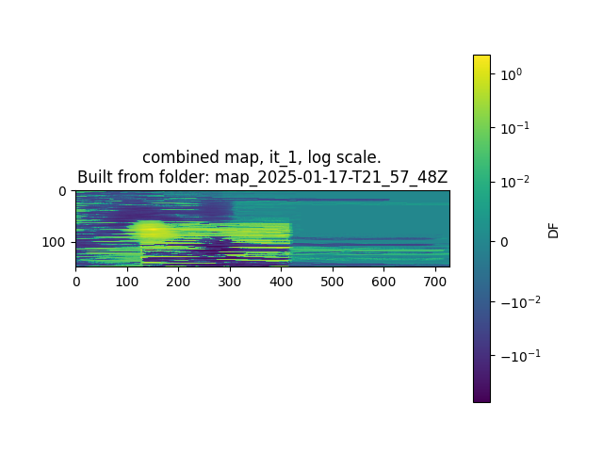
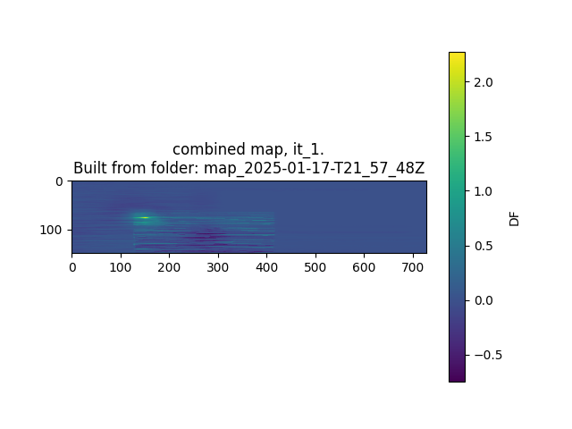
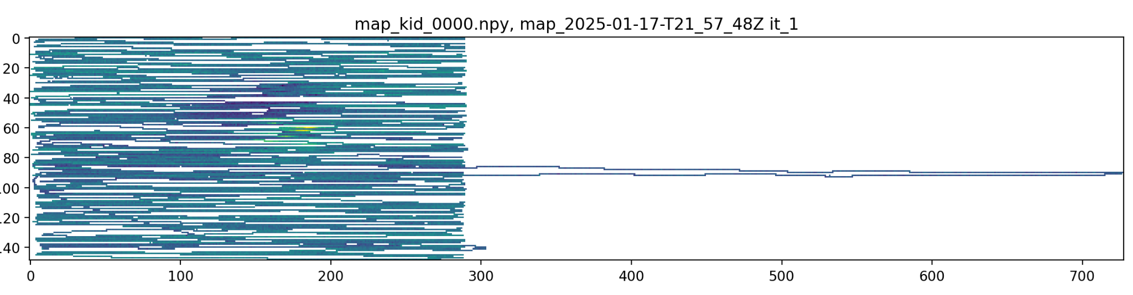
First Outputs
The image has a different resolution and looks to be doubled in size in the x-direction
The first (left) half of the image has the semblance of a source
We also see a sort of rectangular outline between on x ∈ (130, 415)... Is there another source which is breaking the shift on some KIDs?
Heavy horizontal “striping” effect characteristic of bad KIDs (we have not removed them yet)
Is this caused by an incorrect time slice guess?
Could this be fixed by removing KIDs with abnormally large shifts?

Slide 7
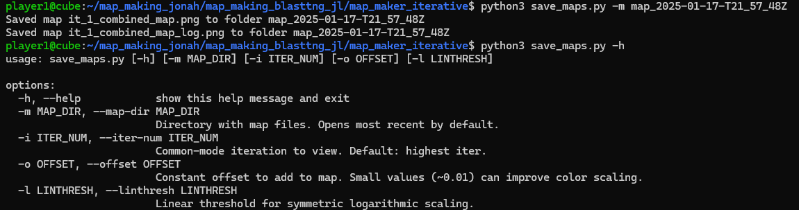
Command Line Utility - save_maps.py
Transferring map data from control computer to local can take >20 min
save_maps.py allows flexible creation of .png maps via CLI
resulting maps can be copied (SCP/SFTP) and viewed

Slide 8
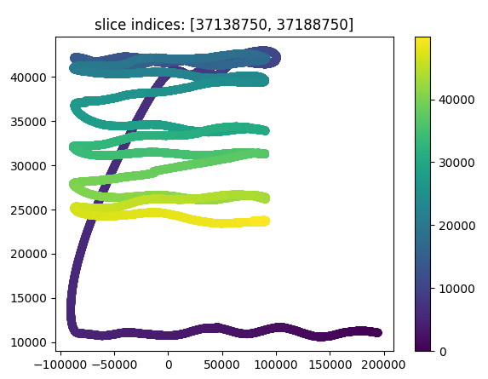
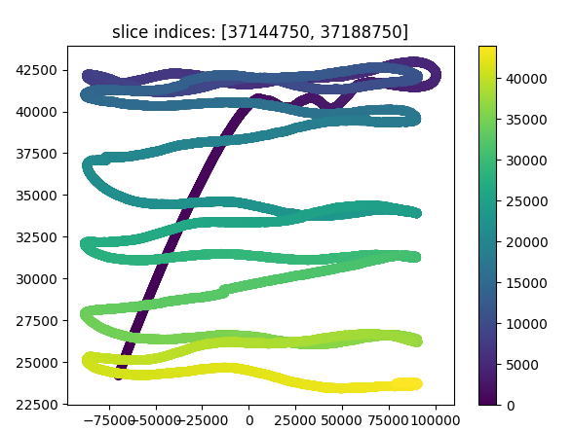
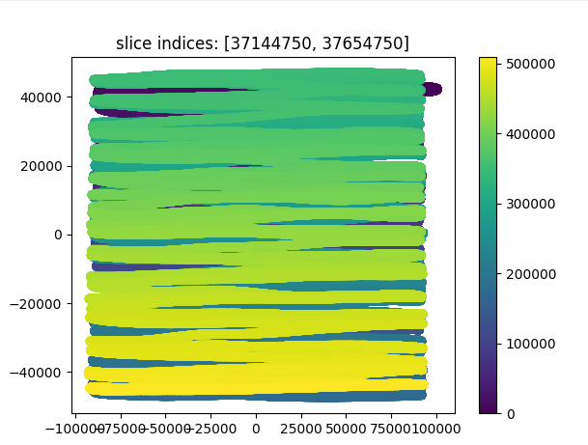
Fixing the Index
Goal: remove the protrusion to the left. Images shown for roach 2
Left: [0:50000], right [13000:5000] → slice_i should be increased by 13000

Slide 9
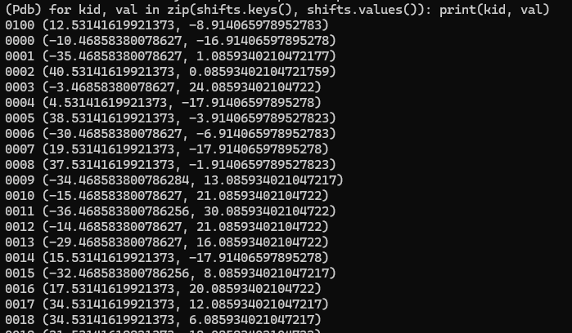
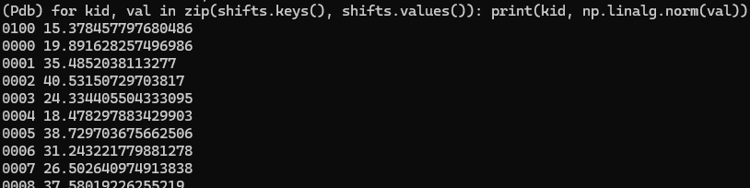
Removing Shift-Anomalous KIDs?
We see in the

Slide 10
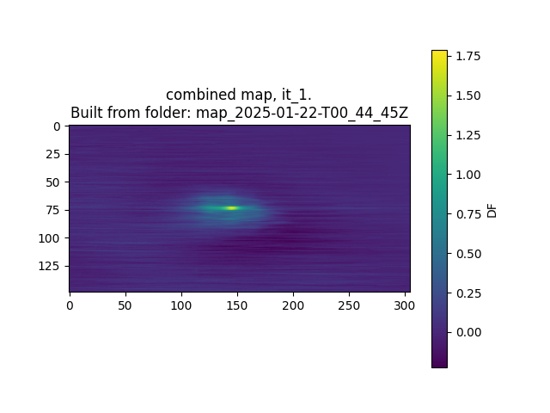
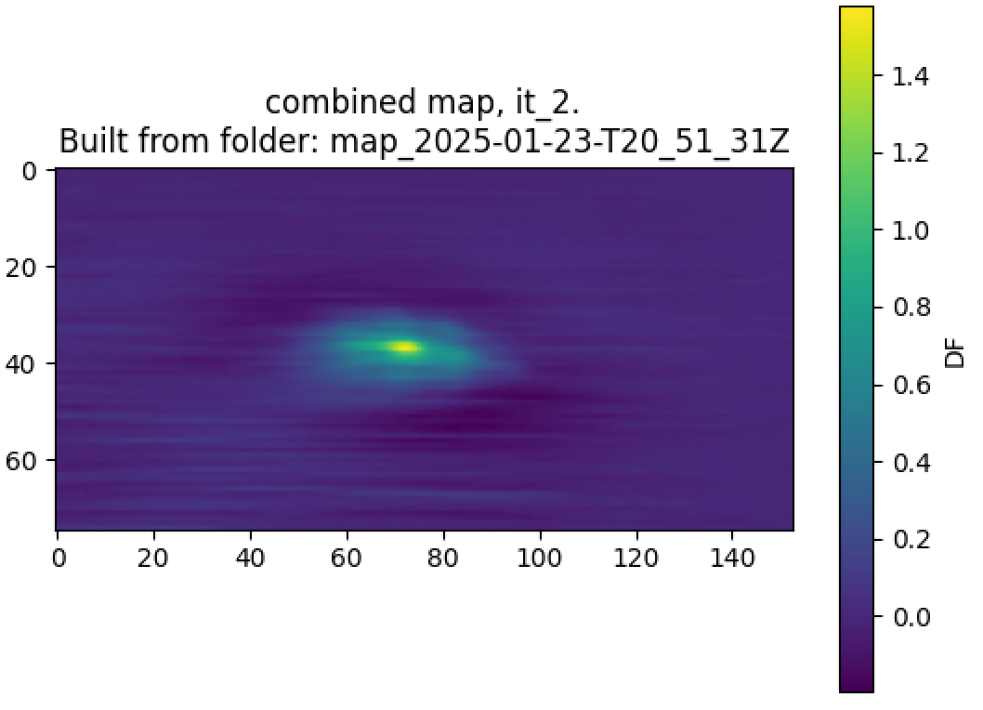
First Images

Slide 11
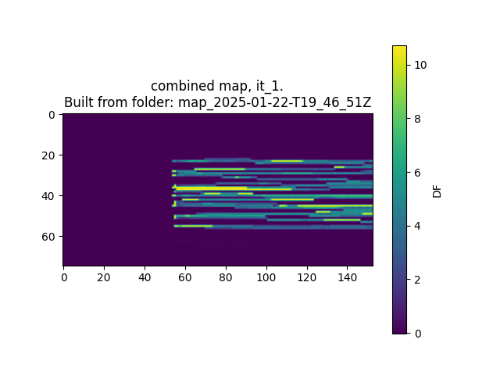

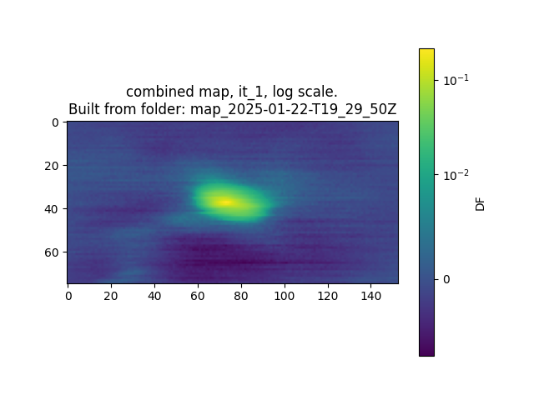
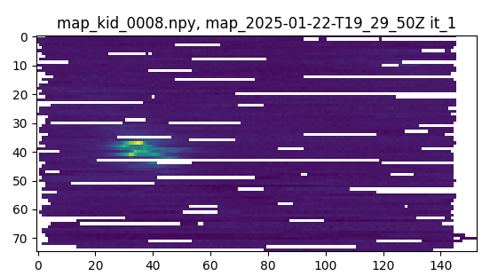
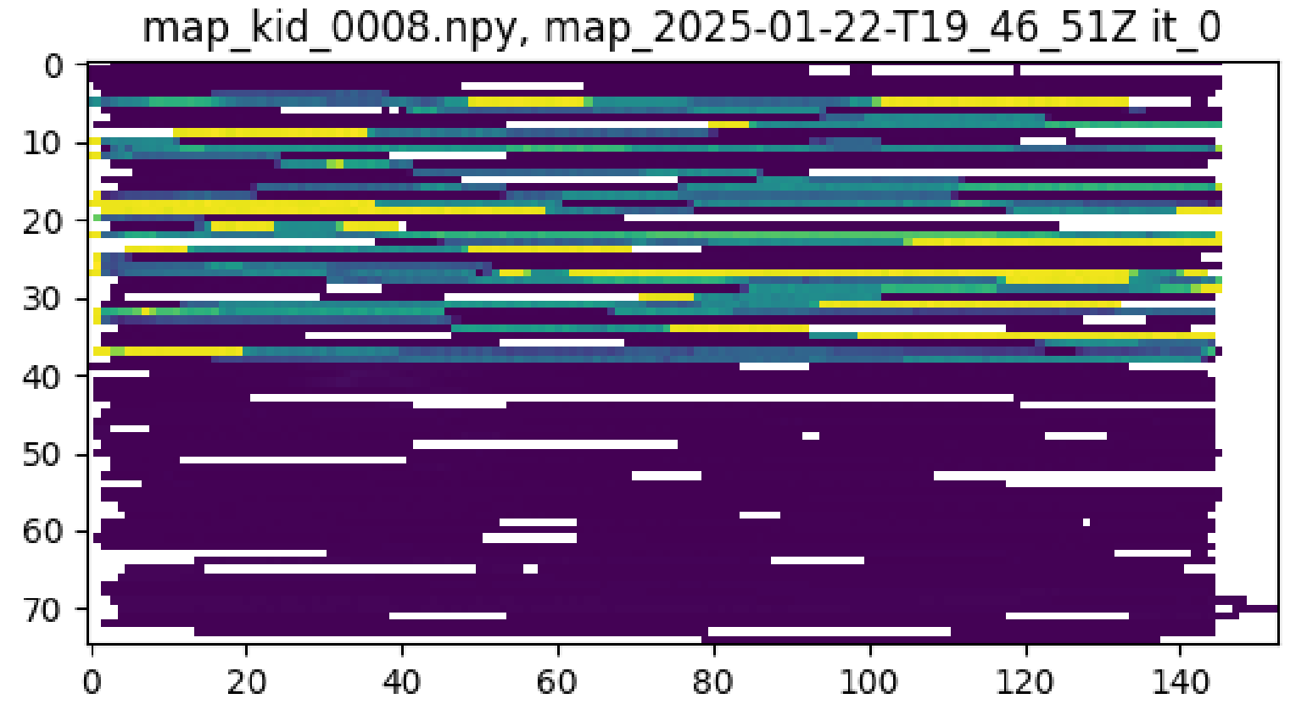
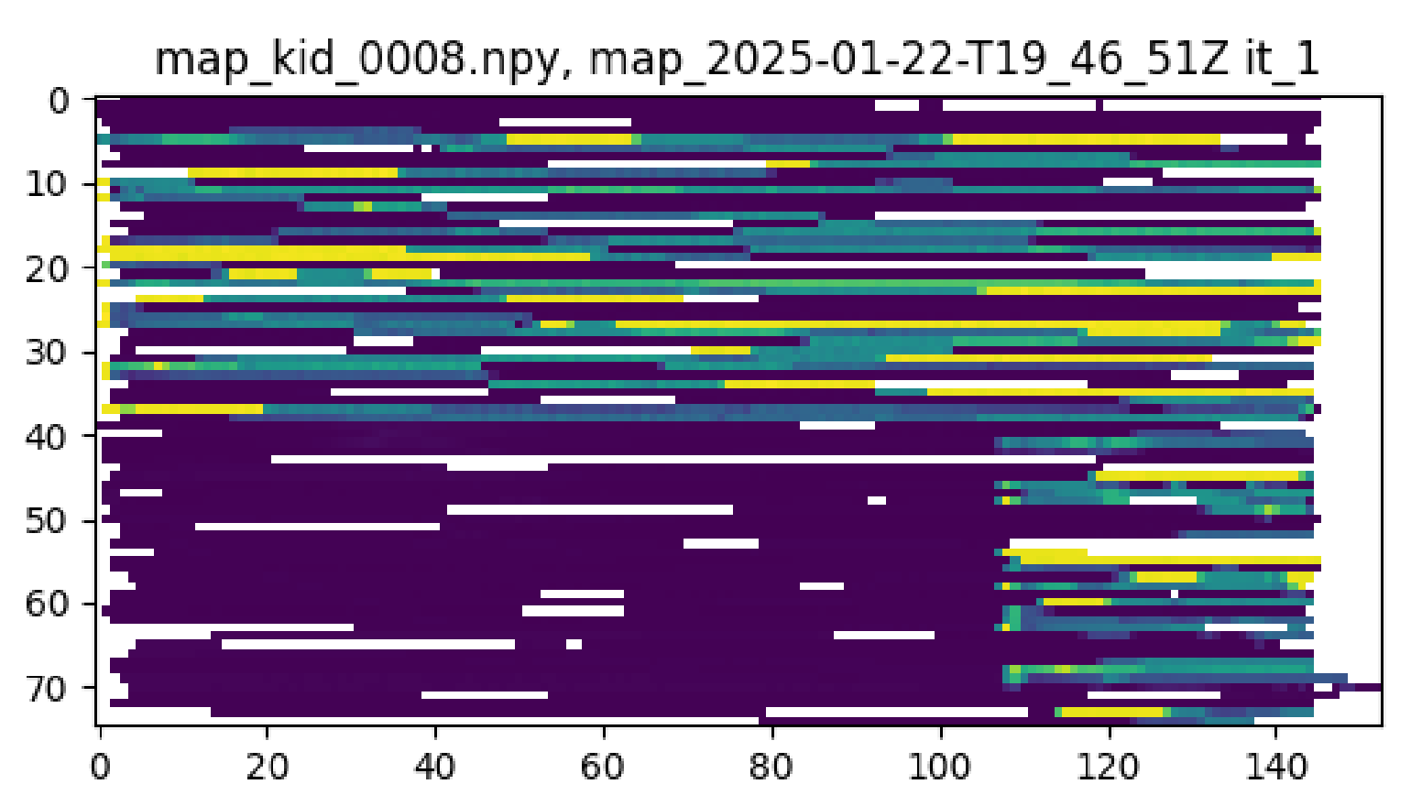
Debugging - Why Do Maps Look Bad?
Roach 1 not working, so restore rejects & layout
broken map: map_2025-01-22-T19_19_14Z
map working again: map_2025-01-22-T19_29_50Z
is layout needed? try without: map_2025-01-22-T19_41_01Z
(answer: no difference, still good without layout)
confirm rejects is the reason the first is bad: map_2025-01-22-T19_46_51Z
not having rejects makes the single kid maps break??

Slide 12
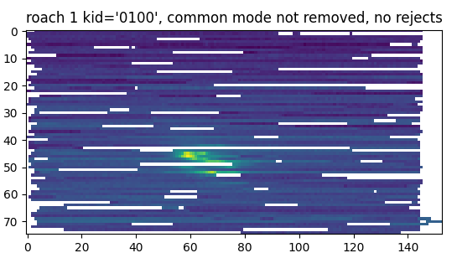
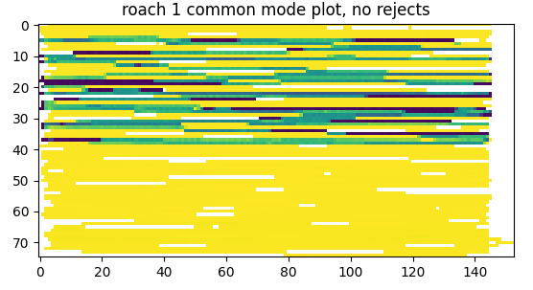
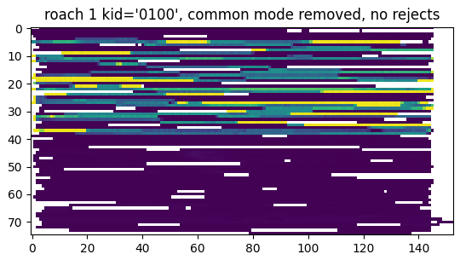
Not Removing Rejects → Junk Common Mode
Note: “no rejects” means that nothing was removed, i.e., bad KIDs are still present in the data

Slide 13
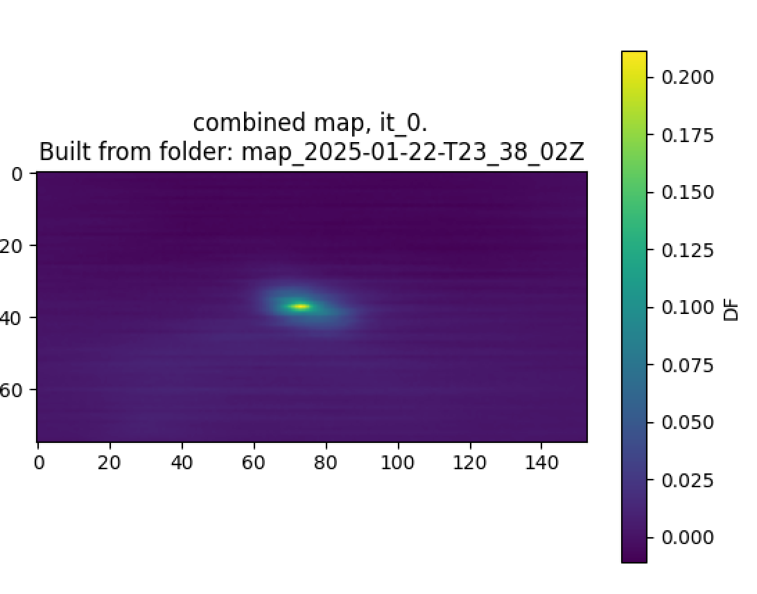
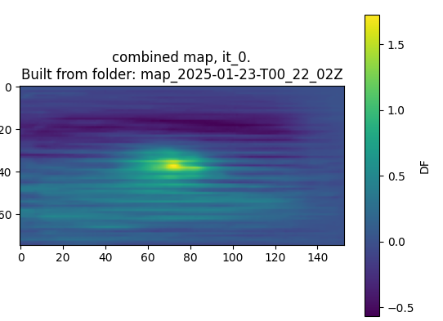
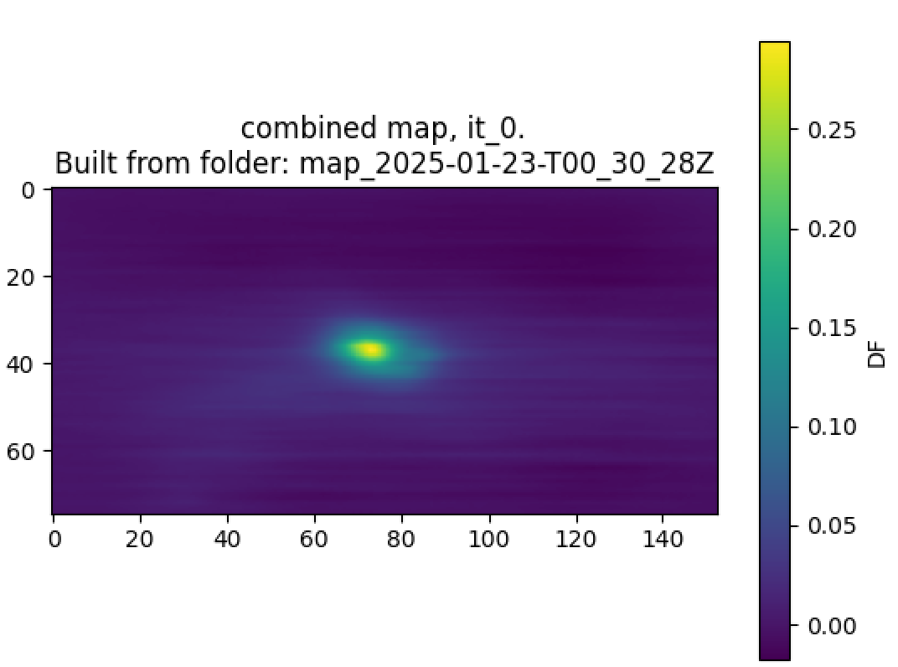
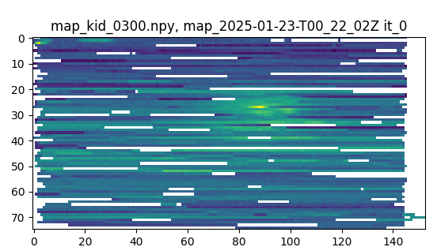
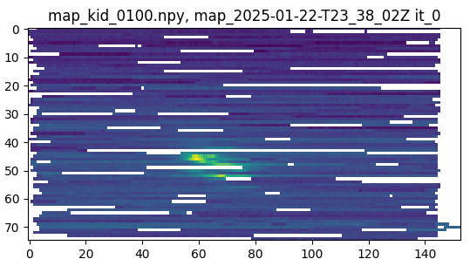
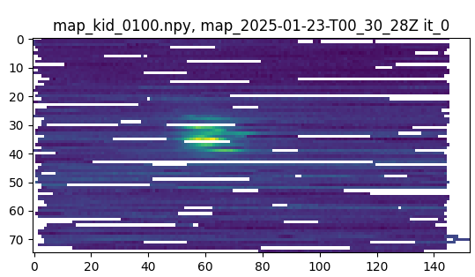
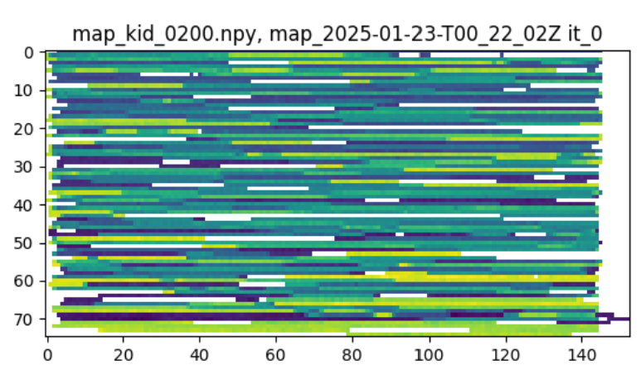
Use All Detectors; Ignore Common Mode
Roach 1
Roach 2
Roach 3

Slide 14
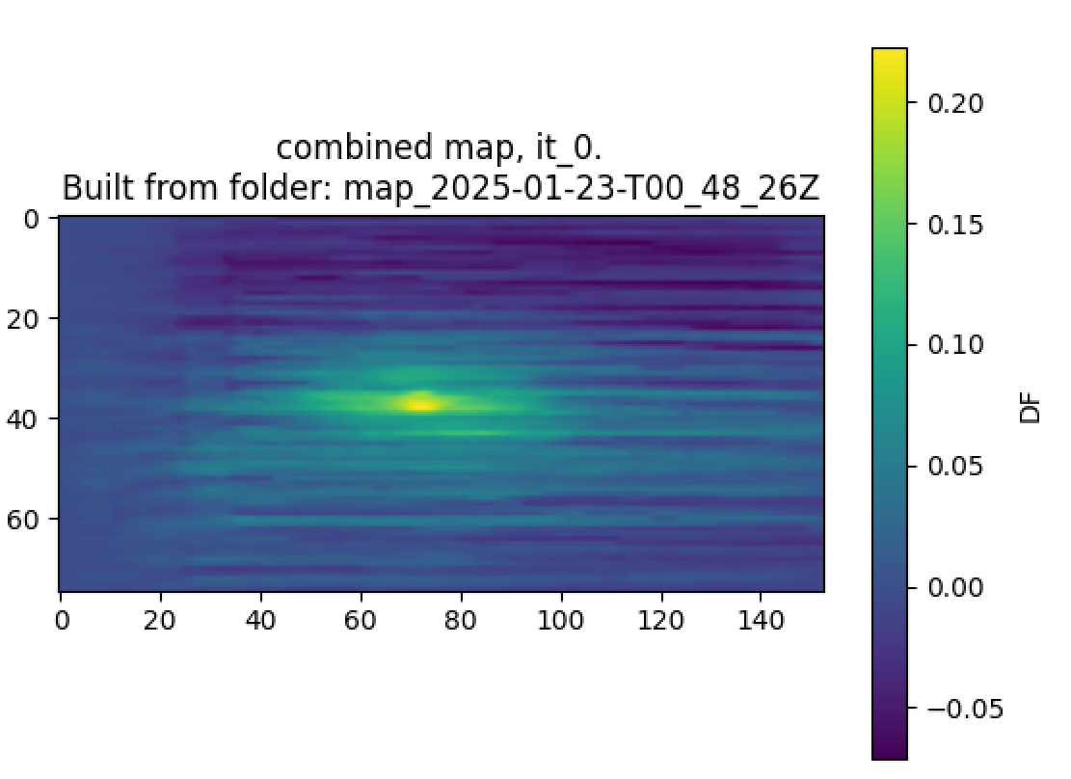
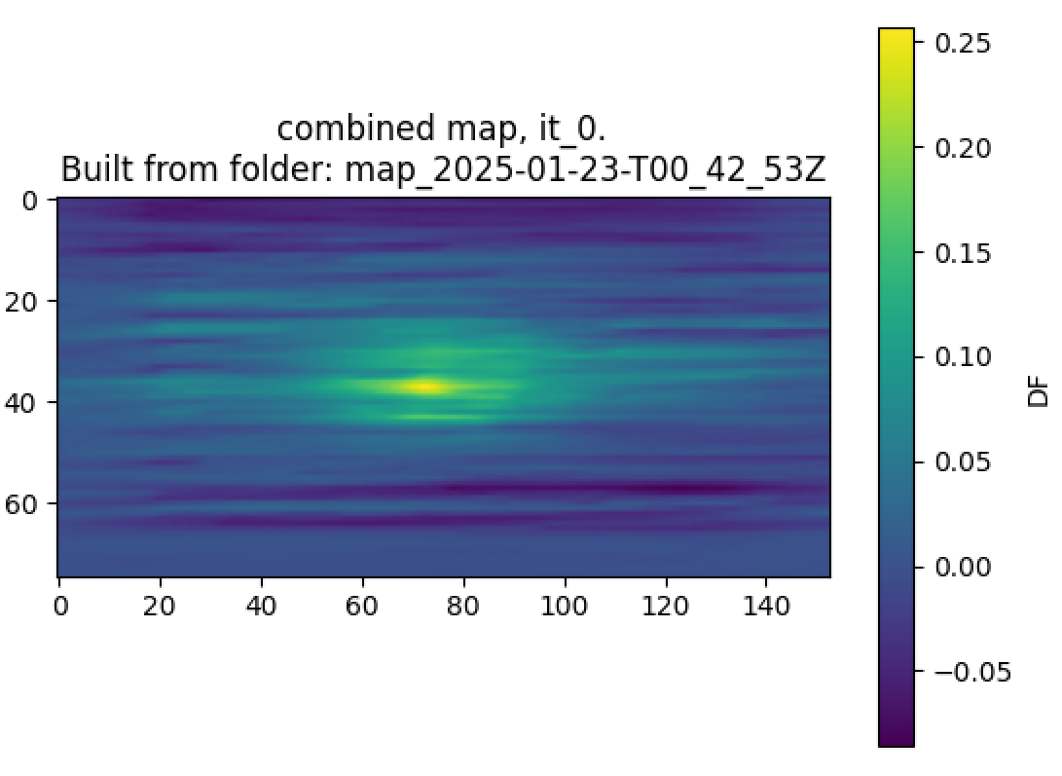
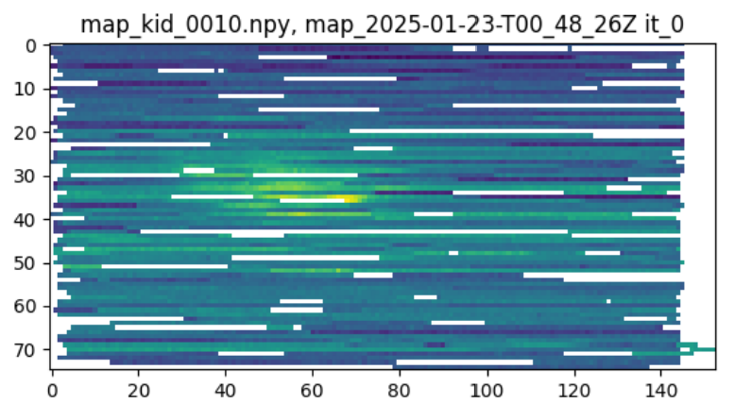
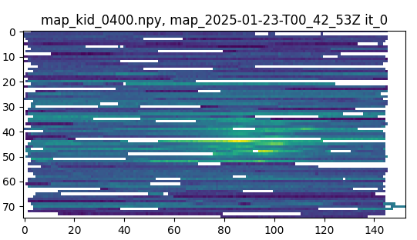
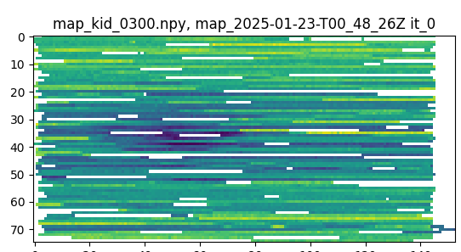
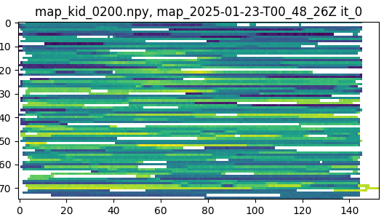
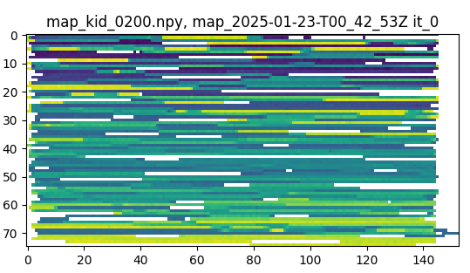
Use All Detectors; No Common Mode Removal
Roach 2
Roach 4
Roach 5
Notes:
Some example single images are shown below. Above images are representative of what most look like, and below are some examples of bad detectors.

Slide 15
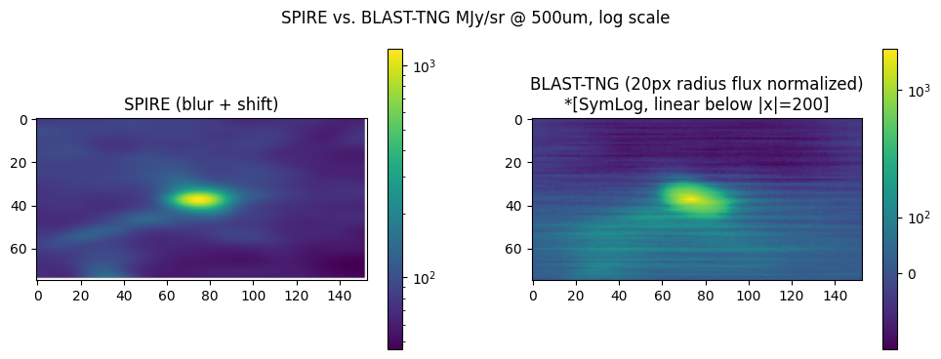
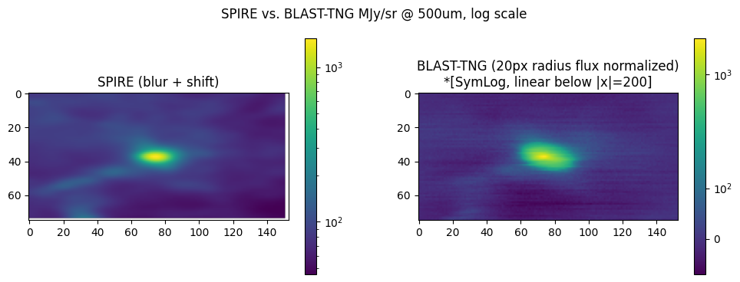
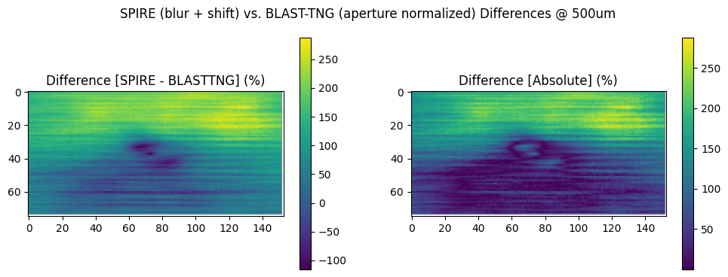
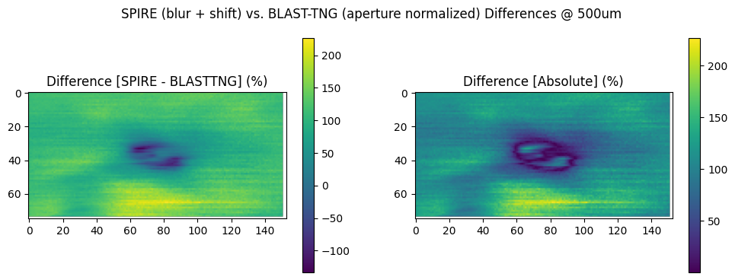
Common-Mode Removal is Essential For Good Maps
Without c(t) removal
With c(t) removal
Therefore, we must remove bad KIDs for 250um roaches to make good maps.

Slide 16
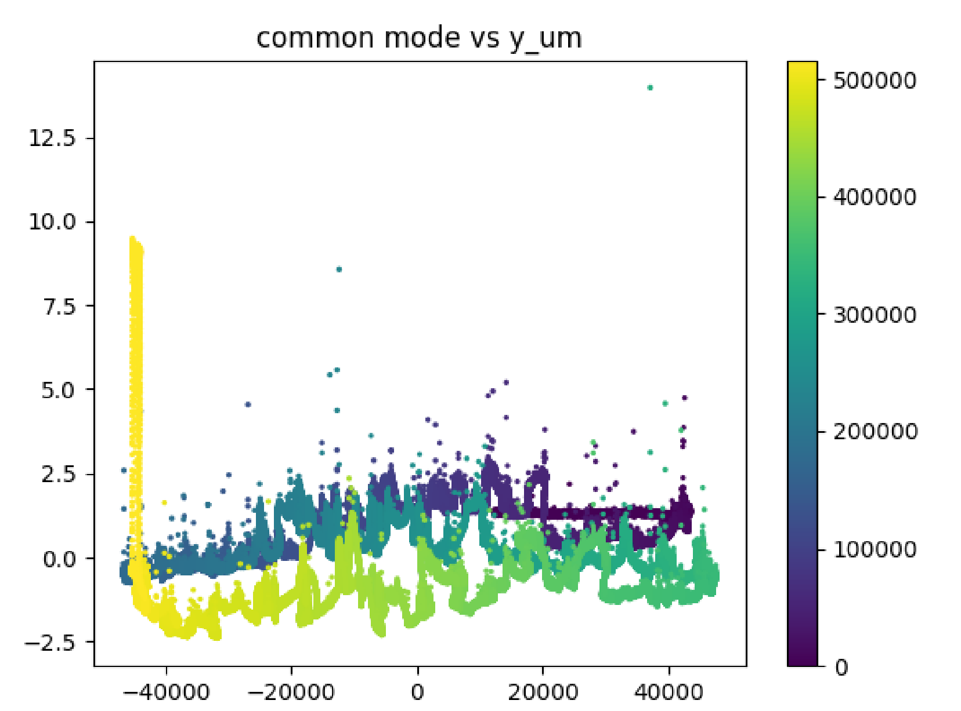

Slide 17
BLAST-TNG Common Mode Signal Removal
Jonah Lee

Slide 18
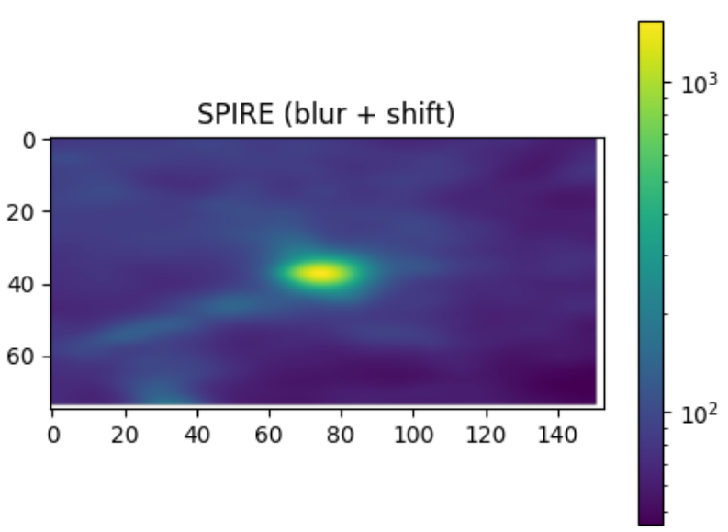
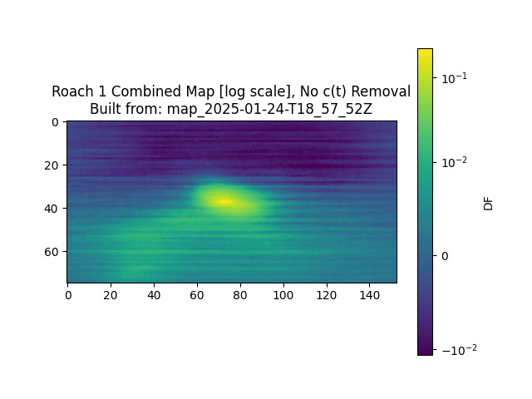
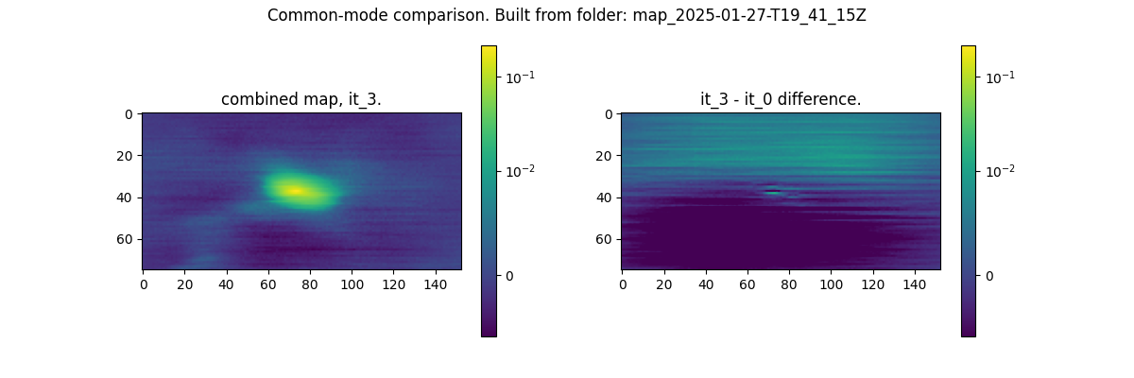
Common-Mode Correction Loop
Roach 1, 500μm
Herschel/SPIRE 500μm reference image, blurred & shifted to match output
Iterative Common-Mode
Correction
Naive Map
Map-Maker Output
+
=

Slide 19
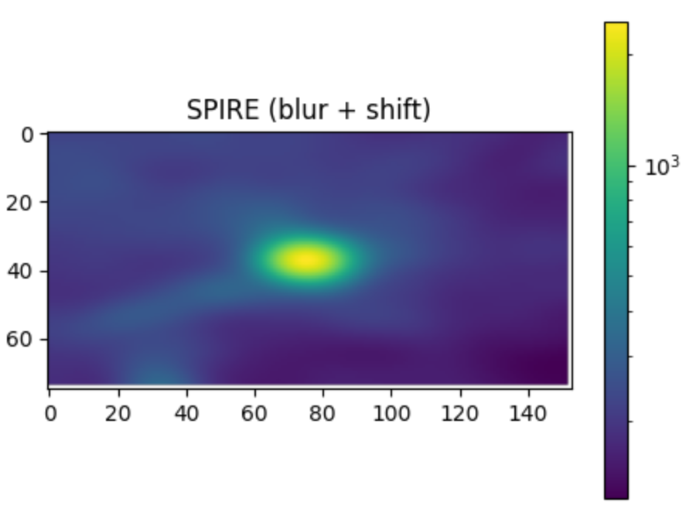
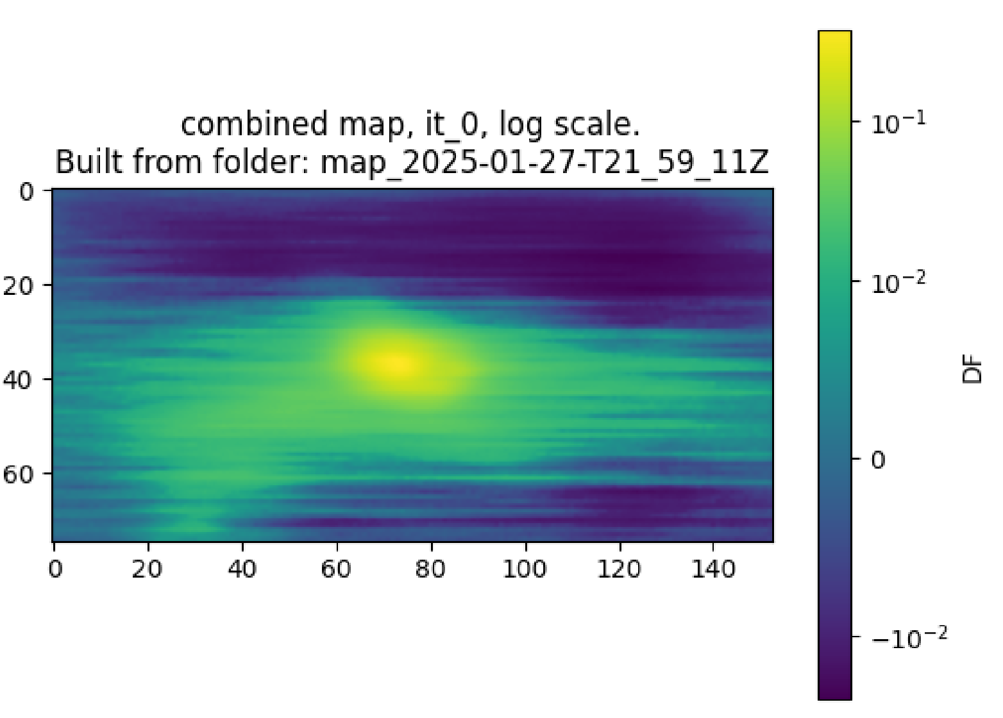
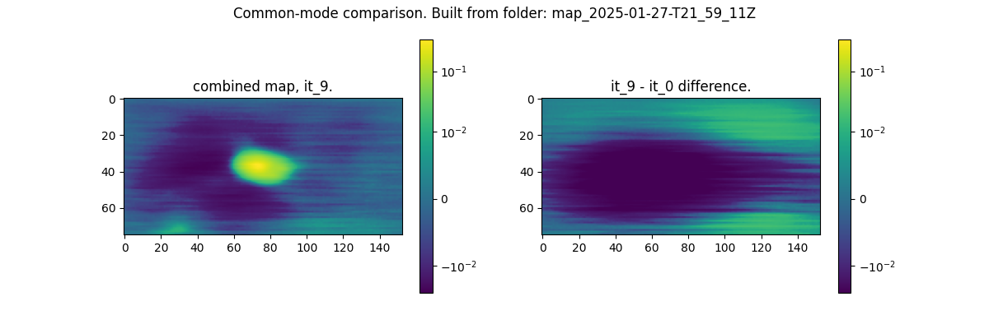
Common-Mode Correction Loop
Roach 3, 350μm
Herschel/SPIRE 350μm reference image, blurred & shifted to match output
Iterative Common-Mode
Correction
Naive Map
Map-Maker Output
+
=

Slide 20
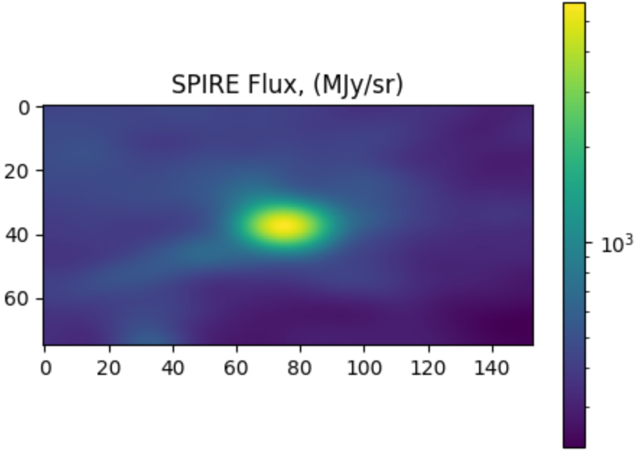
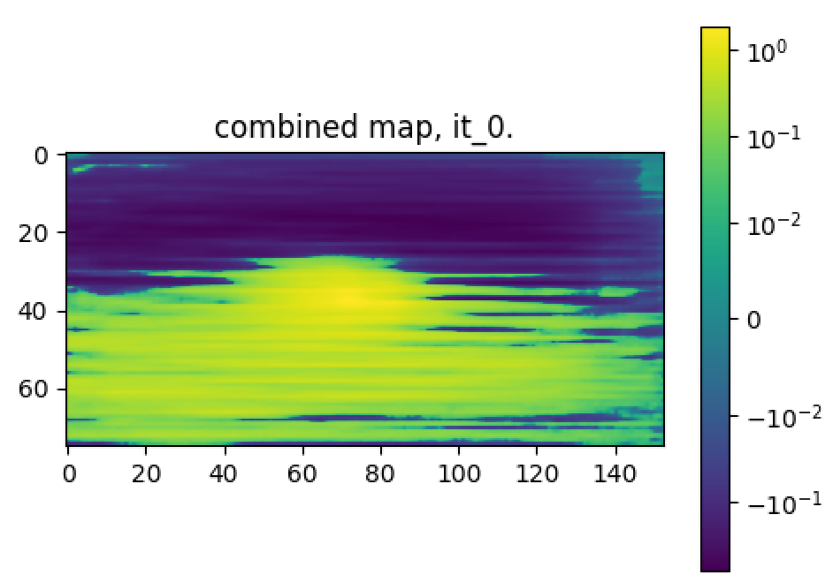
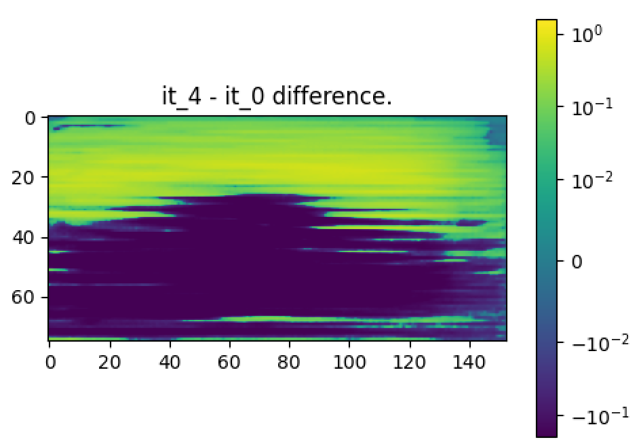
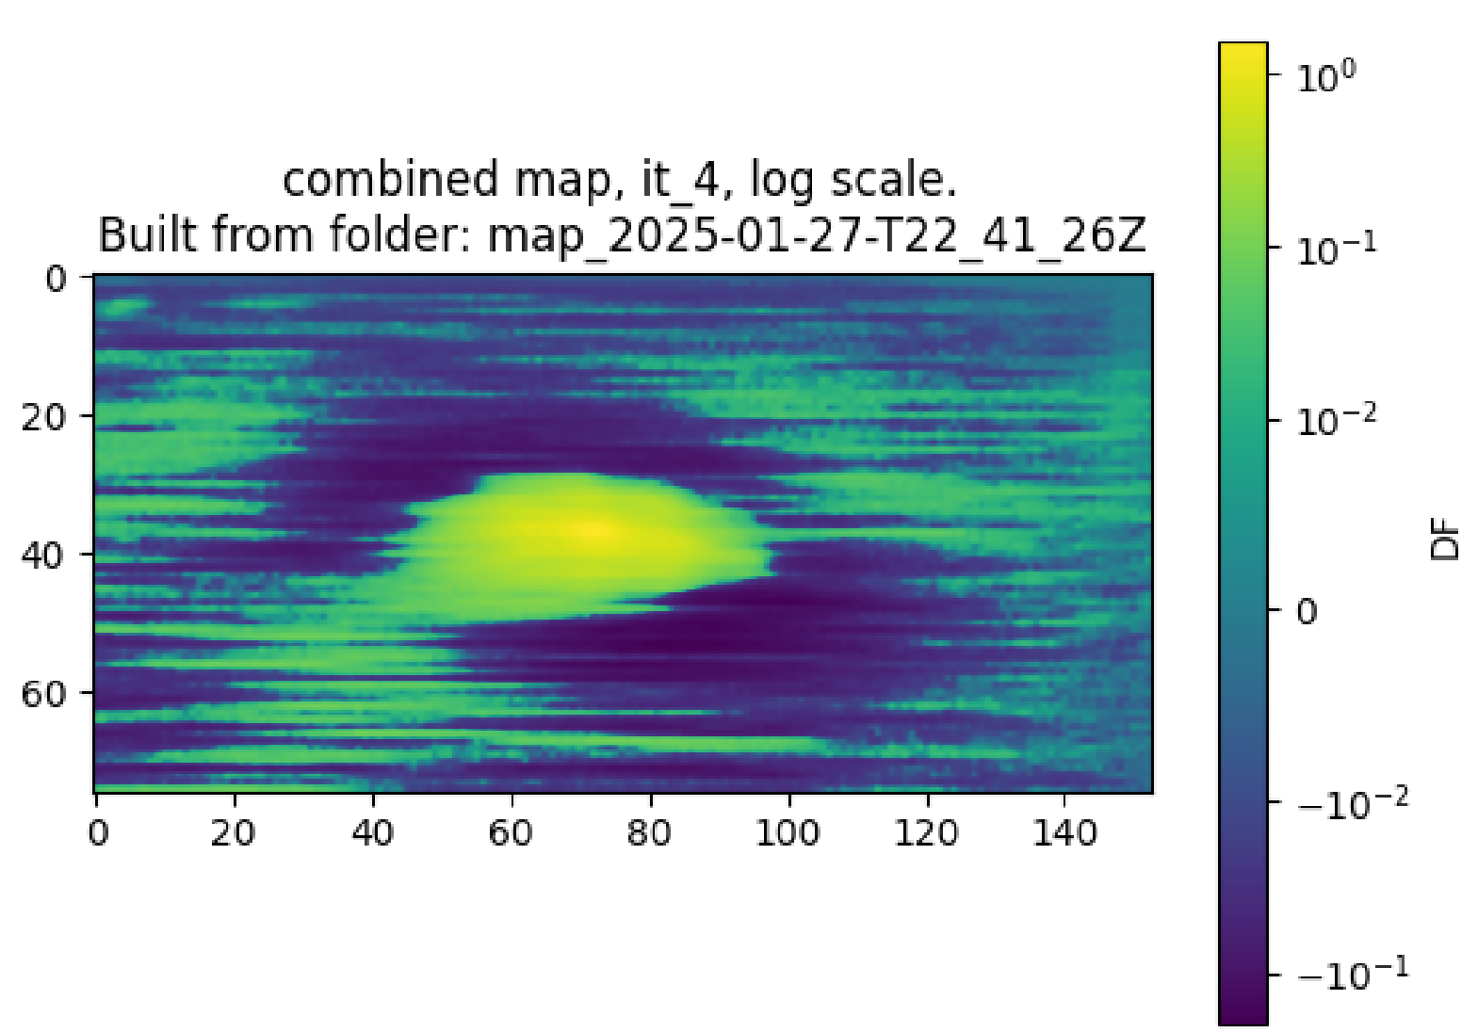
Common-Mode Correction Loop
Roach 2, 250μm
Herschel/SPIRE 250μm reference image, blurred to match output
Iterative Common-Mode
Correction
Naive Map
Map-Maker Output
+
=

Slide 21
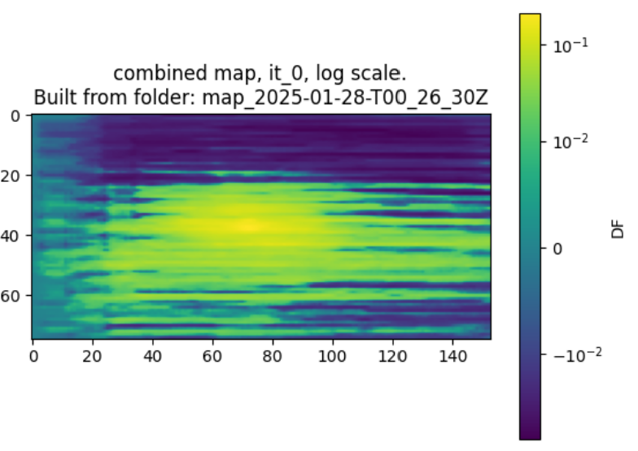


Common-Mode Correction Loop
Roach 4, 250μm
Herschel/SPIRE 250μm reference image, blurred to match output
Iterative Common-Mode
Correction
Naive Map
Map-Maker Output
+
=

Slide 22



Common-Mode Correction Loop
Roach 5, 250μm
Herschel/SPIRE 250μm reference image, blurred to match output
Iterative Common-Mode
Correction
Naive Map
Map-Maker Output
54_07Z
+
=

Slide 23



Common-Mode Correction Loop
Roach 2+4+5, 250μm
Herschel/SPIRE 250μm reference image, blurred to match output
Iterative Common-Mode
Correction
Naive Map
Map-Maker Output
+
=

Slide 24


What is the Source of the Common-Mode Signal?
Hypothesis: sky signal is elevation dependent Note: for these images, each pixel width corresponds to ~27 arcseconds Problem: The c(t) correlation with elevation is less clear for roaches other than roach 1
Slope in center →
0.072 DF / deg
Note: rounding at ends may be due to clipping in the iterative common-mode algorithm
Notes:
Assuming the taper at the ends is an artefact of the clipping, if we take the slope in the middle of the chart we get a slope of 0.00055 df/pixel.
Taking (.00055df/pixel) / (0.0076deg/pixel) we get 0.072 df/deg.
If we then use the SPIRE flux normalization ratio of 12000 MJy/sr/df, we get an elevation gradient of 864MJy/sr/degree (which I admit is a pretty cursed unit).

Slide 25

Combine C(t) for Roach 2, 4, 5
If the problem is that the single arrays are too small, we should take the common-mode as a combination of all arrays.
This may not solve the problem entirely, but will be just as good as roach 1 and 3 wrt. grid size.
After (combined c(t))
Before (separate c(t))

Slide 26

Adjusting Weights
Left: weighted by standard deviation
/ Right: weights by variance

Slide 27



Using the Median
ROACH 2+4+5; Left: mean / Right: median

Slide 28


Mean vs. Median
[toggle animation to view difference] 26_05Z is mean; 01_03Z is median

